Slide 1
Welcome Back – 2023!!!
Today we are going to spend some time reviewing expectations and setting ourselves up for a successful semester.

Slide 3
Enter classroom and refer to board for directions.
Begin warm-up
Warm-up sheet (*new-due Friday each week)
Following slide will provide details.
Take out notebook & homework before starting warm-up.

Slide 5
warm-up
Weekly Warm-ups
Monday-Friday (passed out M, turned in F)
10 points each week
Points cannot be made up-unless absent
1 point each day: warm-up completion/honest attempt
1 point each day: turning homework in on time each day, this is separate from actual HW points

Slide 7
HOMEWORK EXPECTATIONS
Nightly
Monday-Thursday (some exceptions for Friday)
Highlight every homework assignment on paper
Green (understand 100%)
Yellow (can start, but not complete)
Pink (lost and need help)
1 point on HW accounts for highlighting
10 points for each HW assignment
regardless of the number of questions/problems

Slide 9
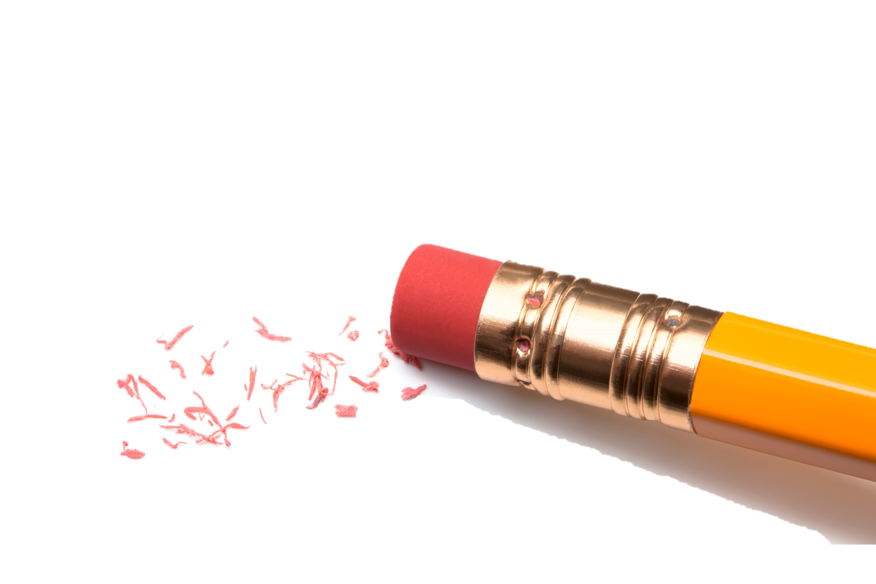
Notebook & binder
Weekly warm-up sheet
Collect new Monday and turn in Friday
PENCILS!!!
Pencils can be purchased with props-not free!
Ask a friend.
NO PENS.
Red pens are ONLY to be used for CORRECTING HW
Work done in pen will be given zero and need to be completed again.

Slide 10
Pens
Red pens have been ruined by many of you bending them
These are ONLY for grading HW and not to be used otherwise
Please bring to me immediately when you notice a broken or leaking pen.
Group supply bins
These bins should always have 4 calculators, 4 red pens, 3-5 highlighters of at least three different colors
Ruining class supplies will result in detention

Slide 11
Absent: for any reason
Absent bin
Sorted by week, and in order I passed out
Week number is listed on board near the date.
Before you ask Ms. Meadows for help, do the following….
Go to the week you missed, look behind Math 7 or Math 7/8. If you missed a handout, it will be there.
If you can’t find, ask a friend or…
Check One Note during Enrichment to look at the assignment from the day you were absent.
See me when you’ve exhausted all of the above

